Slide 1

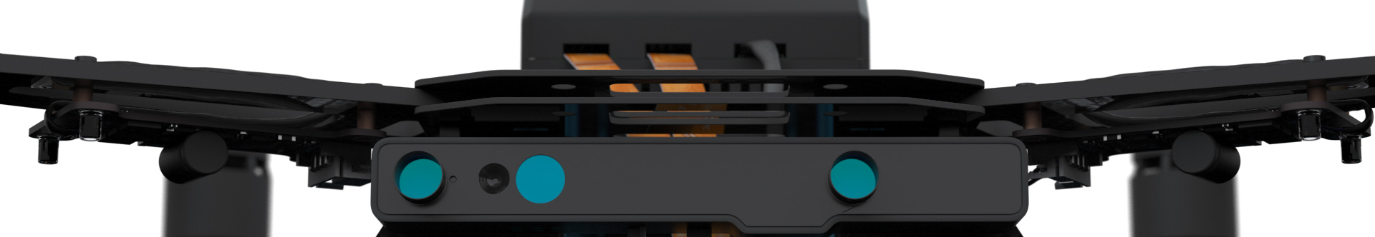
Autonomous Drone Engineer C1 – OutOfBox and Flashing
Paul.Guermonprez@intel.com Autonomous Drone Solutions Architect

Slide 2
Contents of the Intel Aero ReadyToFly Drone
Included in the RTF Drone:
The Drone, assembled
A remote
Not included:
USB hub, USB-OTG and HDMI cables required for flashing and setup
Battery and battery charger for flights
Or power adapter for desk development
For references, check the github: https://github.com/intel-aero/meta-intel-aero/wiki/01-About-Intel-Aero

Slide 3
Typical lab setup
The drone, connected to:
A power supply (simpler, safer than a battery)
A USB hub for the keyboard, mouse and USB key (for flashing)
A HDMI screen
Calibration computer/tablet:
A device running QGroundControl, the software used to calibrate the drone sensors
Can be Linux, Windows, Mac, Android, iOS, …
If portable, you can bring this device with you when you’re flying
Development computer (now shown on the photo):
Soon after the initial setup, you’ll switch to your regular computer (any OS) to develop software for Intel Aero, accessing it over the wifi network with ssh.
Note: The development computer can be the same machine as the calibration computer/table

Slide 4
Flashing
You’ll download: a large .iso file
You’ll create a bootable USB disk from your development station
You’ll flash:
The Operating System (Linux Yocto) running on the Intel Aero board
The BIOS of the Intel Aero board
The firmware of the Intel Aero Flight Controller
The FPGA layout
Note: the first flashing procedure requires the keyboard + screen + USB key, but the following flashing procedures can be done over ssh + USB key.
For details, consult: https://github.com/intel-aero/meta-intel-aero/wiki/02-Initial-Setup

Slide 5
Video recording of the installation

Slide 6
Calibration and first flight
After flashing the Flight Controller, sensors need to be recalibrated.
QGroundControl (QGC) running on your calibration computer will guide through the procedure.
At the end of the procedure, you should be able to arm the motors (without the propellers). It will proove everything is connected.
For details, consult: https://github.com/intel-aero/meta-intel-aero/wiki/02-Initial-Setup#calibration
If you have a battery, you can proceed to the first flight.
https://github.com/intel-aero/meta-intel-aero/wiki/03-First-flight

Slide 7
Video recording of the calibration

Slide 8
Conclusion
We:
Flashed all the components
Recalibrated the sensors
Made our first flight, or at least armed the motors
We’re ready to open a terminal and start coding!

Slide 9
Thanks
Paul.Guermonprez@intel.com
https://intel-aero.github.io
Released under Creative Commons-BY creativecommons.org/licenses/by/2.0/

